Slide 1
Object Detection
Team DetectoVision
Mehedi Hasan, Visaal Nekkanti, Andrew Woska, Abin George
https://github.com/agwoska/DetectoVision

Slide 2
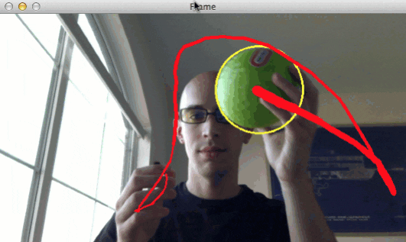
Project Overview
Develop a near real-time detection system to track physical objects using FPGA technology for enhanced image processing.
Features
High-Speed Processing
Low Latency Performance
Advanced Object Tracking
Applications: Robotics, surveillance, automated manufacturing
Notes:
Just repeat skipped slide
Goals: what you are doing and why? With an example

Slide 3
Goals
Project Goals
Camera produces images for the system to analyze
Computer vision algorithm processes image received
Produce a meaningful output that tracks the object’s position
Produce a visual with the modified images
Simulation Goals
Synthesized each module individually
UART recognizes and receives image
CV Algorithms providing meaningful outputs
Visual output for simulated ball X & Y coordinates

Slide 4

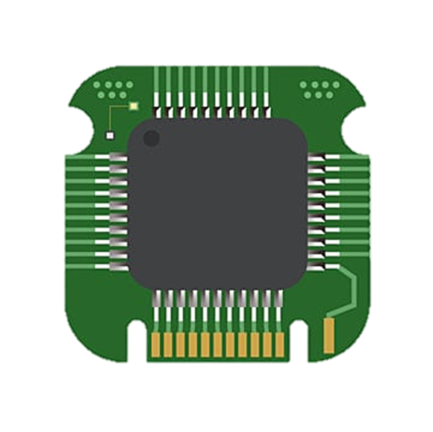

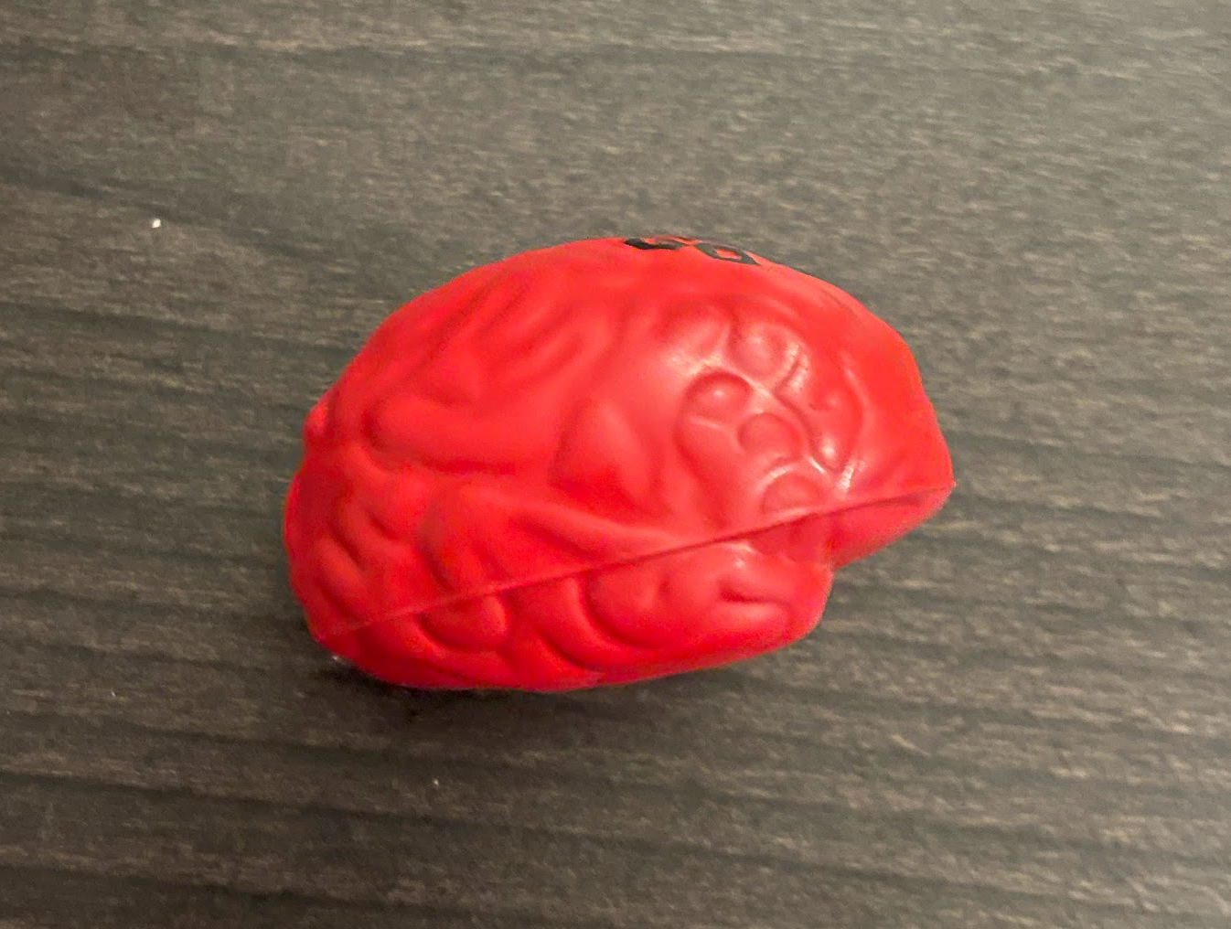
System Overview
Object Image Captured Image Processing Output

Slide 5
System Specifications
Hardware Requirements:
Xilinx Artix 7 FPGA
Nexys A7
Basys 3
ESP32-CAM Microcontroller
OV7670
PC
FPGA Peripherals/Interfaces:
UART
VGA
BRAM
FIFO Register
What are we trying to achieve?
Real time image processing without significant lag.
Whilst, minimizing memory cost and maximizing performance.

Slide 6
Ch1: Camera
Andrew

Slide 7
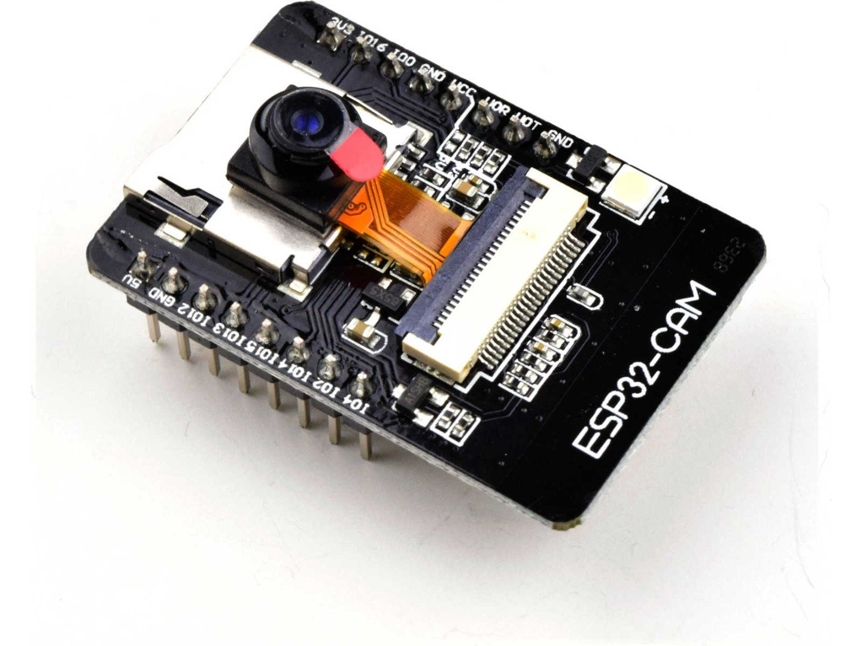
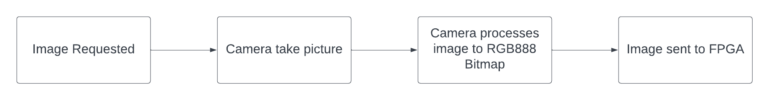
Camera Pipeline
ESP32-CAM with OV2640 2MP camera module
Creates a server instance and initiates UART for communication
PC acts as middleman between camera and FPGA
Notes:
ESP32-CAM used to generate necessary images and posts them to its web server. This web server is communicating with the PC which can request new image capture and getting the previous image in system memory.
Image of ESP32-CAM from: https://www.universal-solder.ca/wp-content/uploads/2020/03/2184_5507a683-d21a-4e1b-a165-ac7bec357cb20.jpg

Slide 8
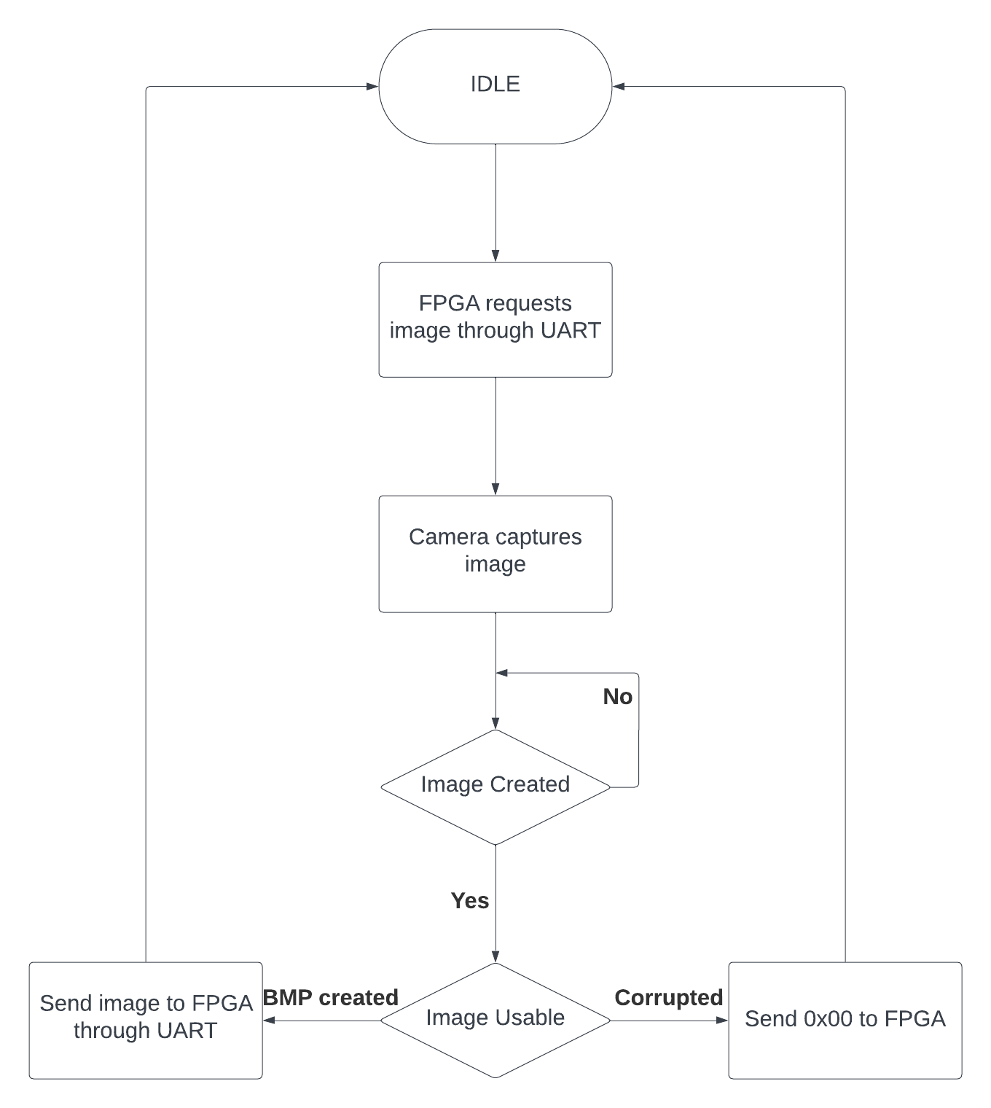

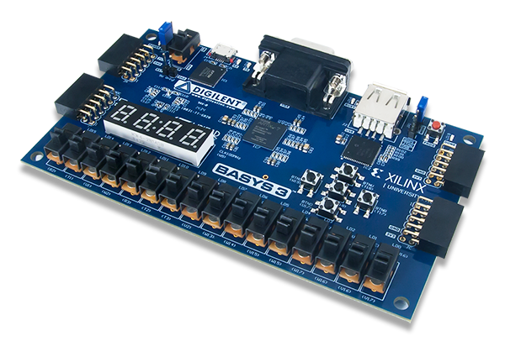

FPGA to ESP32
PC solves problems camera causes
PC provides power and UART communication
Slows potential processing speed
Guarantees usable image

Slide 9
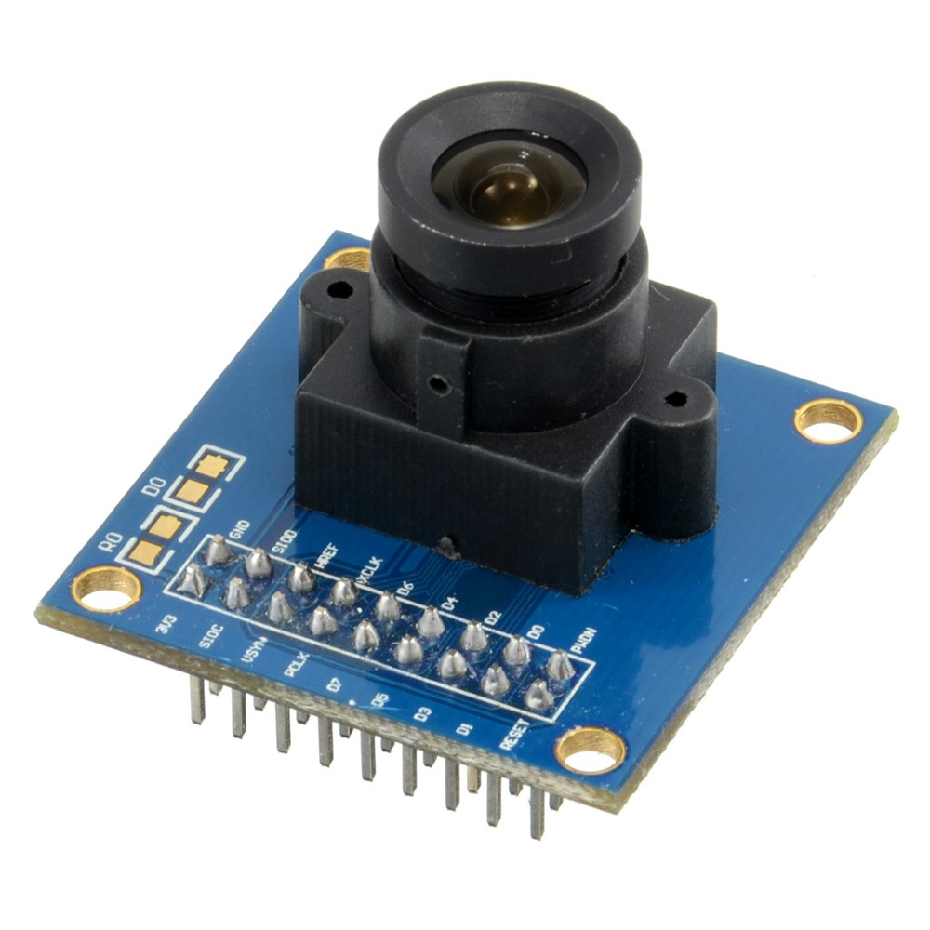
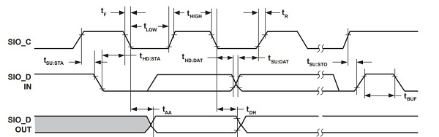
SSCB
OV7670 uses a similar protocol to I²C
Plugs into 2 of the PMOD ports on the FPGA
Supports VGA resolution images

Slide 10
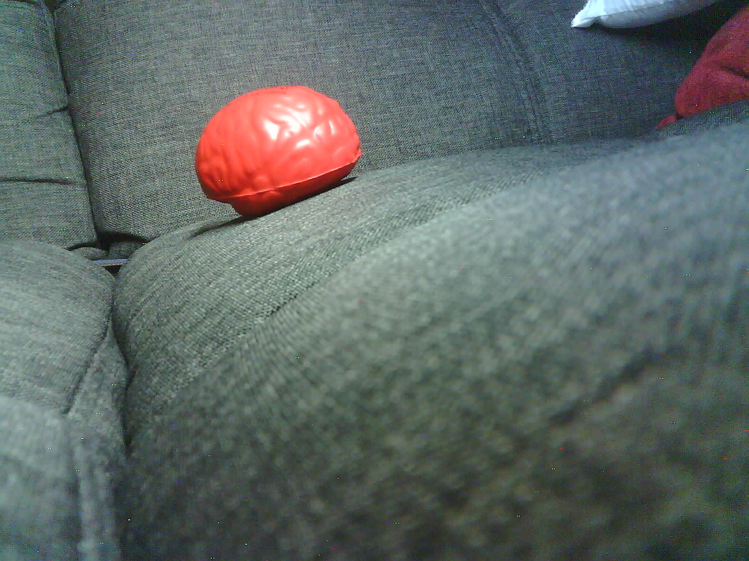
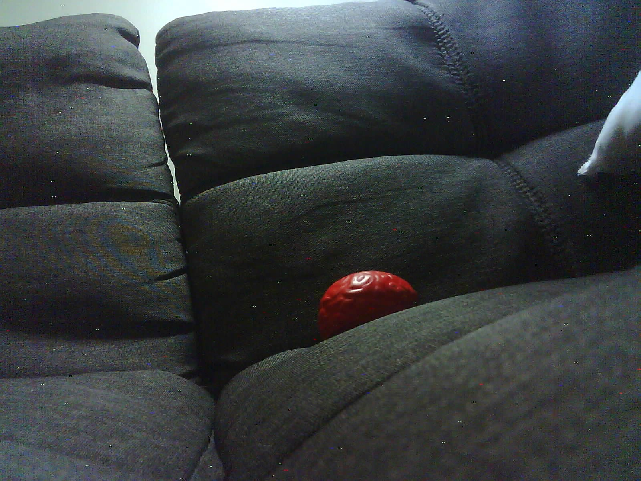
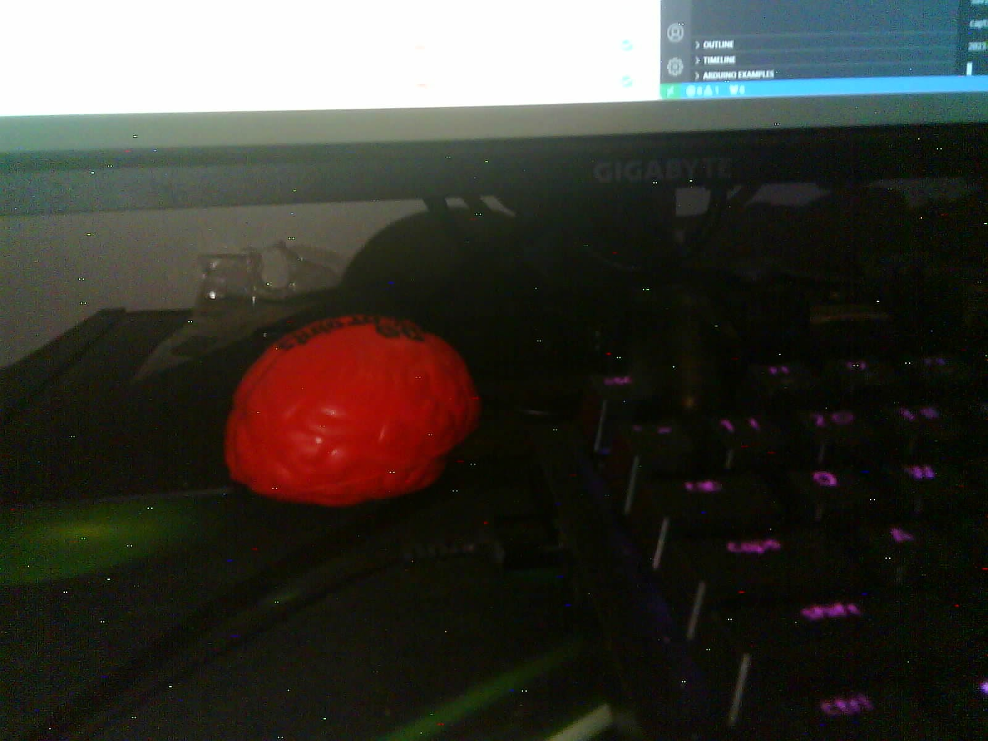
Camera Image
Camera frame size can be 1600x1200 (current), 800x600, or 240x240

Slide 11
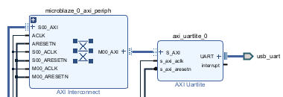
ESP32 to FPGA
Uses Xilinx IP to generate relevant Verilog code with extra module to capture image
module detectovision_wrapper (reset, sys_clock, usb_uart_rxd, usb_uart_txd); input reset; input sys_clock; input usb_uart_rxd; output usb_uart_txd; wire reset; wire sys_clock; wire usb_uart_rxd; wire usb_uart_txd; dv_uart dv_uart_i (.reset(reset), .sys_clock(sys_clock), .usb_uart_rxd(usb_uart_rxd), .usb_uart_txd(usb_uart_txd)); endmodule

Slide 12
Ch2: Image Processing
Abin & Mehedi

Slide 13
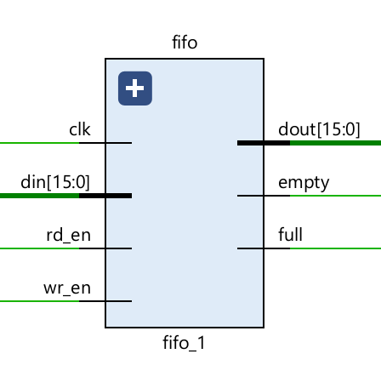
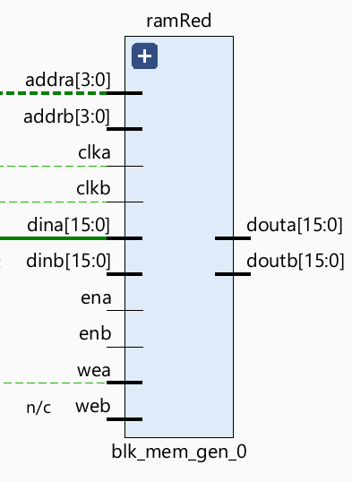
Image Processing Pipeline
Camera*
Grey Scale + Color Masking
FIFO
Buffer (IP)
BRAM 150KB (IP)
VGA*
Hough Transform
Edge Detection
BRAM 150KB (IP)
* Simulation results obtained didn’t use the camera nor the VGA. Instead read and wrote to a bitmap file.

Slide 14
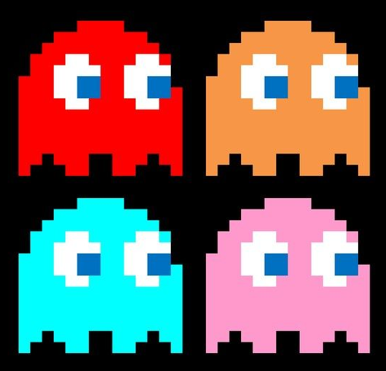
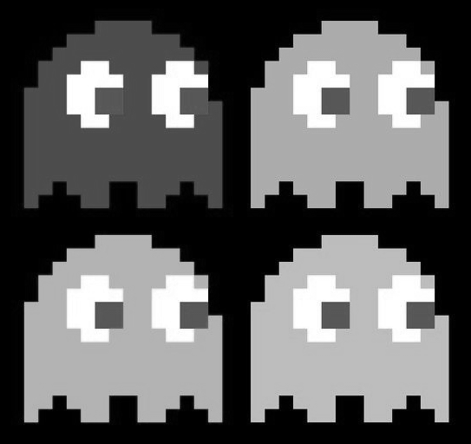
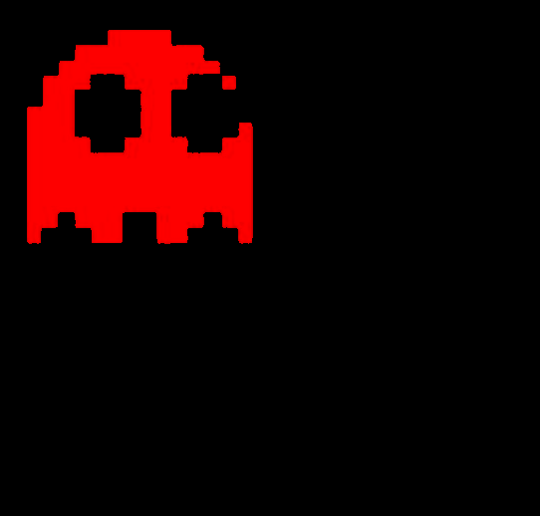
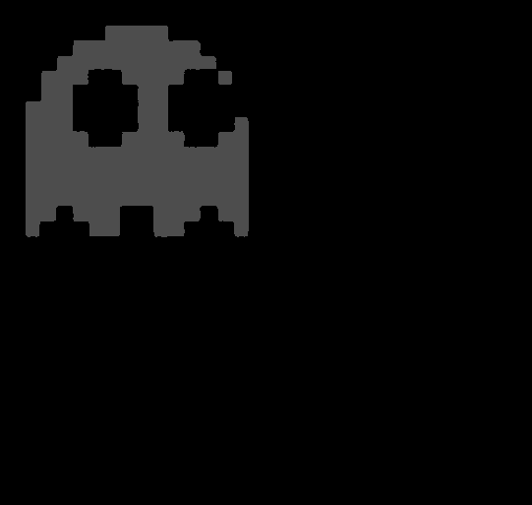
Grey Scale & Color Masking
Camera*
FIFO
Buffer (IP)
Grey Scale + Color Masking
BRAM 150KB (IP)
Edge Detection
BRAM 150KB (IP)
Hough Transform
VGA*
if (R > thresholdMin && G < thresholdMax && B < thresholdMax) outputPixel <= 77; else outputPixel <= 0;
ORIGINAL
GREY SCALING
COLOR MASKING
COLOR MASKING & GREY SCALING

Slide 15

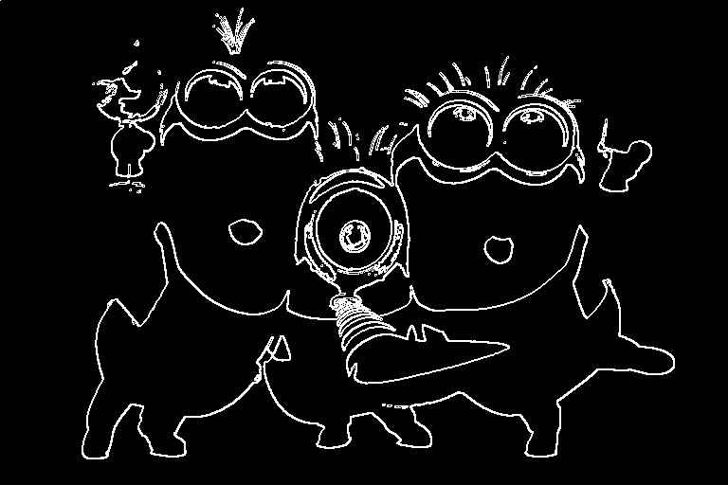
Edge Detection
COULD BE PARALLELIZED TO IMPROVE SPEED !
Camera*
FIFO
Buffer (IP)
Grey Scale + Color Masking
BRAM 150KB (IP)
Edge Detection
BRAM 150KB (IP)
Hough Transform
VGA*
ul | uc | ur
ml | x | mr
dl | dc | dr
ul
.
.
.
*
EDGE THRESHOLD (X)
sorbelFunction edgeDetect (
.CAMERA_CLK(CAMERA_CLK),
.rst(rst),
.ul(ul),
.uc(uc),
.ur(ur),
.ml(ml),
.mc(mc),
.mr(mr),
.dl(dl),
.dc(dc),
.dr(dr),
.outPixel(editedPixel),
.writeBackImage(writeBackImage)
);
uc
+
dr
*
Edge detection at pixel x
Convolution Operator

Slide 16
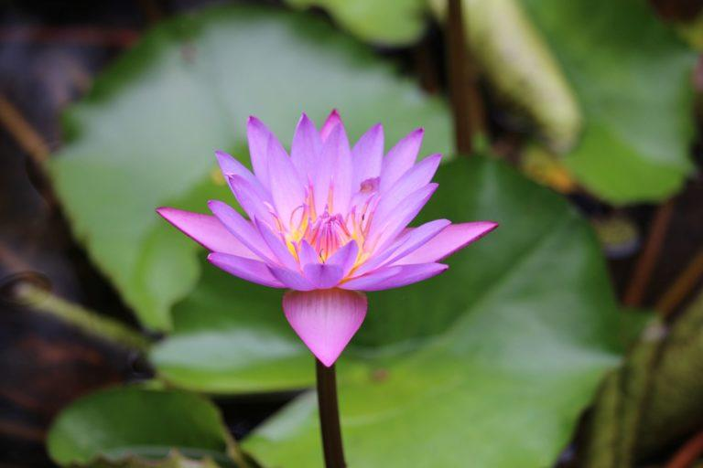
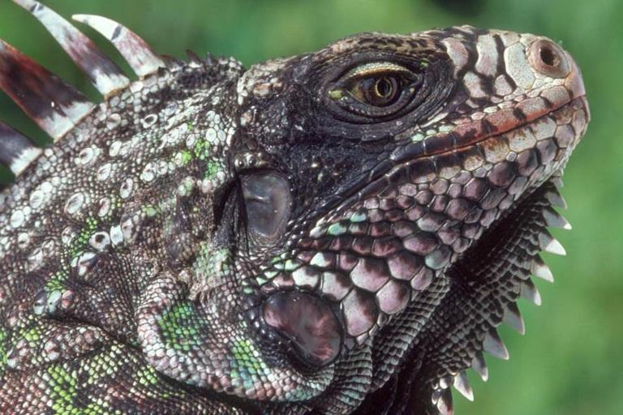
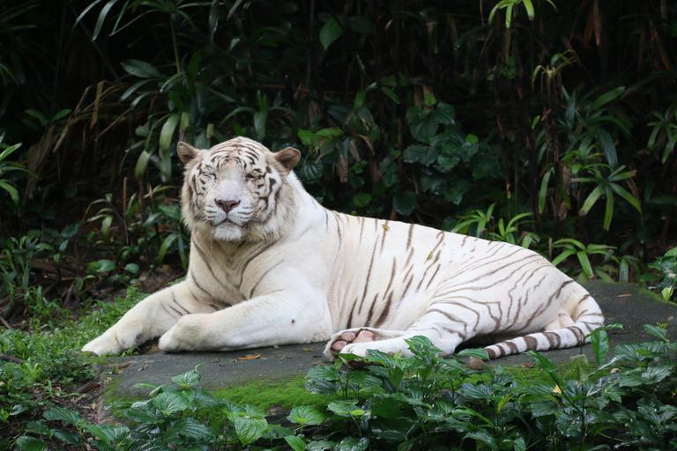

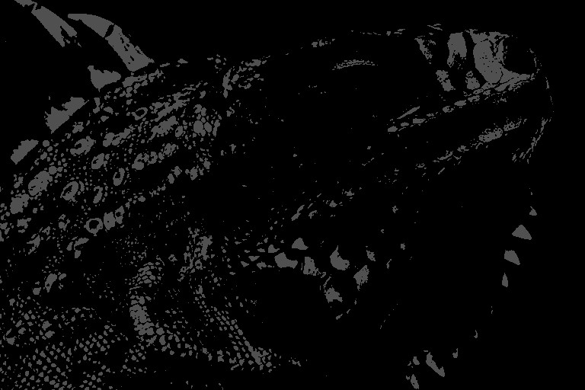
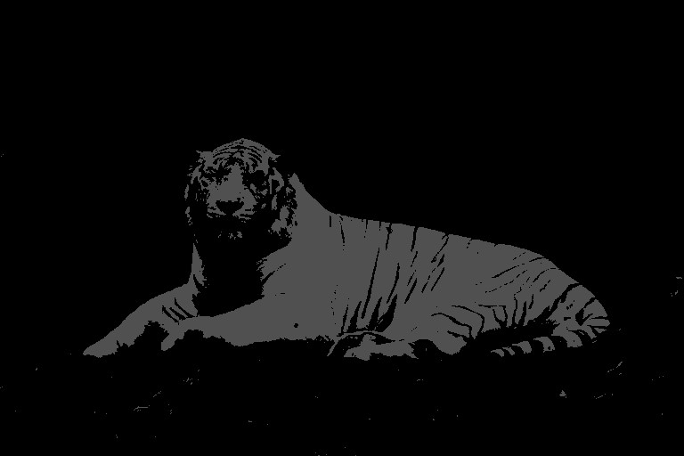
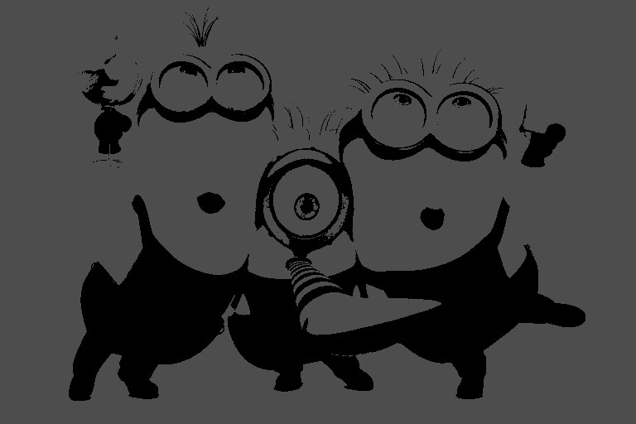
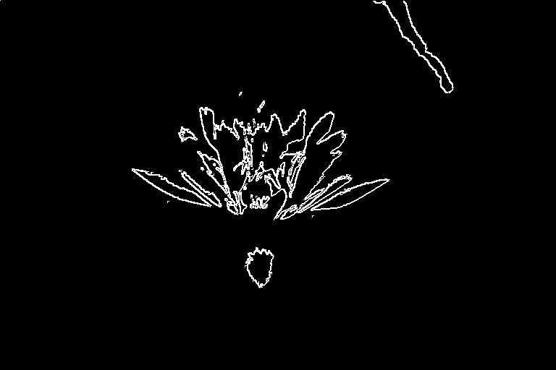
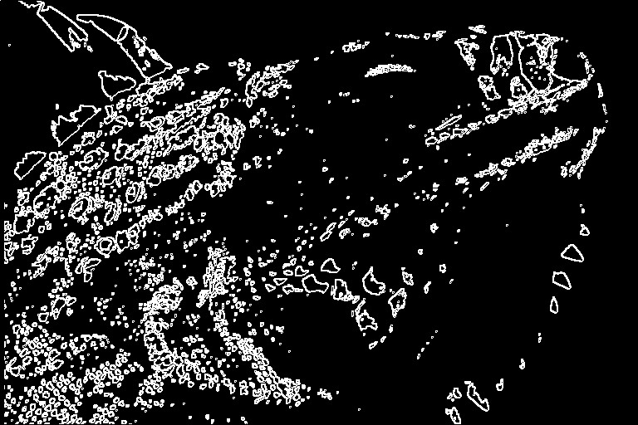
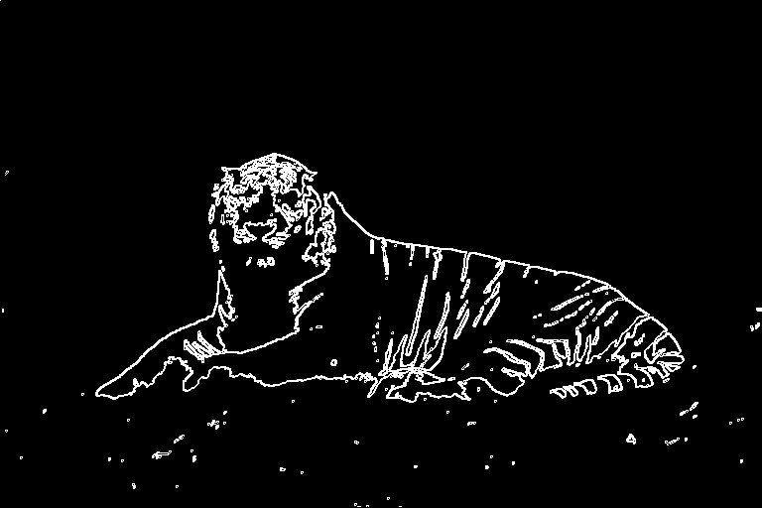
Edge Detection Testbench

Slide 17
Hough Transform
Camera*
FIFO
Buffer (IP)
Grey Scale + Color Masking
BRAM 150KB (IP)
Edge Detection
BRAM 150KB (IP)
Hough Transform
VGA*
Take an edge point from edge detection image.

Slide 18
Hough Transform
Camera*
FIFO
Buffer (IP)
Grey Scale + Color Masking
BRAM 150KB (IP)
Edge Detection
BRAM 150KB (IP)
Hough Transform
VGA*
Take an edge point from edge detection image.
Vote for all pixels with a circle locus of radius r as potential circle center.

Slide 19
Hough Transform
Camera*
FIFO
Buffer (IP)
Grey Scale + Color Masking
BRAM 150KB (IP)
Edge Detection
BRAM 150KB (IP)
Hough Transform
VGA*
Take an edge point from edge detection image.
Vote for all pixels with a circle locus of radius r as potential circle center.
Repeat for other edge points (more points the better).

Slide 20
Hough Transform
Camera*
FIFO
Buffer (IP)
Grey Scale + Color Masking
BRAM 150KB (IP)
Edge Detection
BRAM 150KB (IP)
Hough Transform
VGA*
Take an edge point from edge detection image.
Vote for all pixels with a circle locus of radius r as potential circle center.
Repeat for other edge points (more points the better).
Choose the pixel with the greatest votes.

Slide 21
Hough Transform
Requires voting memory for all the pixels (~ 100KB)
Can we make this more memory efficient?
(Hint: YES)
Camera*
FIFO
Buffer (IP)
Grey Scale + Color Masking
BRAM 150KB (IP)
Edge Detection
BRAM 150KB (IP)
Hough Transform
VGA*
Take an edge point from edge detection image.
Vote for all pixels with a circle locus of radius r as potential circle center.
Repeat for other edge points (more points the better).
Choose the pixel with the greatest votes.

Slide 22

Hough Transform
Requires voting memory for all the pixels (~ 100KB)
Can we make this more memory efficient?
(Hint: YES)
Camera*
FIFO
Buffer (IP)
Grey Scale + Color Masking
BRAM 150KB (IP)
Edge Detection
BRAM 150KB (IP)
Hough Transform
VGA*
Take an edge point from edge detection image.
Vote for all pixels with a circle locus of radius r as potential circle center.
Repeat for other edge points (more points the better).
Choose the pixel with the greatest votes.

Slide 23
Hough Transform (DetectoVision Method)
Camera*
FIFO
Buffer (IP)
Grey Scale + Color Masking
BRAM 150KB (IP)
Edge Detection
BRAM 150KB (IP)
Hough Transform
VGA*
Accumulator: 0
3'b00:
begin nextState_hough <= 3'b001; inY_hough <= inY_hough; inX_hough <= inX_hough + radius; end 3'b01: begin nextState_hough <= 3'b010; inY_hough <= inY_hough; inX_hough <= inX_hough - 2*radius; end 3'b10: begin nextState_hough <= 3'b011; inY_hough <= inY_hough - radius; inX_hough <= inX_hough + radius; end
3'b11: begin nextState_hough <= 3'b100; inY_hough <= inY_hough + 2* radius; inX_hough <= inX_hough; end default: begin nextState_hough <= 3'b000; inY_hough = inY_hough - radius;
FIND NEXT POINT TO TEST AS CENTER
if(last pixel reached)
begin
SEND BEST X AND Y COORD TO VGA
end
end
S0
houghTransform_top circleDetect ( clk, rst, start, edgePix, X, Y, state, idealX, idealY)

Slide 24
Hough Transform (DetectoVision Method)
Camera*
FIFO
Buffer (IP)
Grey Scale + Color Masking
BRAM 150KB (IP)
Edge Detection
BRAM 150KB (IP)
Hough Transform
VGA*
Accumulator: 1
3'b00:
begin nextState_hough <= 3'b001; inY_hough <= inY_hough; inX_hough <= inX_hough + radius; end 3'b01: begin nextState_hough <= 3'b010; inY_hough <= inY_hough; inX_hough <= inX_hough - 2*radius; end 3'b10: begin nextState_hough <= 3'b011; inY_hough <= inY_hough - radius; inX_hough <= inX_hough + radius; end
3'b11: begin nextState_hough <= 3'b100; inY_hough <= inY_hough + 2* radius; inX_hough <= inX_hough; end default: begin nextState_hough <= 3'b000; inY_hough = inY_hough - radius;
FIND NEXT POINT TO TEST AS CENTER
if(last pixel reached)
begin
SEND BEST X AND Y COORD TO VGA
end
end
S0
S1
houghTransform_top circleDetect ( clk, rst, start, edgePix, X, Y, state, idealX, idealY)

Slide 25
Hough Transform (DetectoVision Method)
Camera*
FIFO
Buffer (IP)
Grey Scale + Color Masking
BRAM 150KB (IP)
Edge Detection
BRAM 150KB (IP)
Hough Transform
VGA*
Accumulator: 2
3'b00:
begin nextState_hough <= 3'b001; inY_hough <= inY_hough; inX_hough <= inX_hough + radius; end 3'b01: begin nextState_hough <= 3'b010; inY_hough <= inY_hough; inX_hough <= inX_hough - 2*radius; end 3'b10: begin nextState_hough <= 3'b011; inY_hough <= inY_hough - radius; inX_hough <= inX_hough + radius; end
3'b11: begin nextState_hough <= 3'b100; inY_hough <= inY_hough + 2* radius; inX_hough <= inX_hough; end default: begin nextState_hough <= 3'b000; inY_hough = inY_hough - radius;
FIND NEXT POINT TO TEST AS CENTER
if(last pixel reached)
begin
SEND BEST X AND Y COORD TO VGA
end
end
S2
S0
S1
houghTransform_top circleDetect ( clk, rst, start, edgePix, X, Y, state, idealX, idealY)

Slide 26
Hough Transform (DetectoVision Method)
Camera*
FIFO
Buffer (IP)
Grey Scale + Color Masking
BRAM 150KB (IP)
Edge Detection
BRAM 150KB (IP)
Hough Transform
VGA*
Accumulator: 3
3'b00:
begin nextState_hough <= 3'b001; inY_hough <= inY_hough; inX_hough <= inX_hough + radius; end 3'b01: begin nextState_hough <= 3'b010; inY_hough <= inY_hough; inX_hough <= inX_hough - 2*radius; end 3'b10: begin nextState_hough <= 3'b011; inY_hough <= inY_hough - radius; inX_hough <= inX_hough + radius; end
3'b11: begin nextState_hough <= 3'b100; inY_hough <= inY_hough + 2* radius; inX_hough <= inX_hough; end default: begin nextState_hough <= 3'b000; inY_hough = inY_hough - radius;
FIND NEXT POINT TO TEST AS CENTER
if(last pixel reached)
begin
SEND BEST X AND Y COORD TO VGA
end
end
S2
S0
S1
S3
houghTransform_top circleDetect ( clk, rst, start, edgePix, X, Y, state, idealX, idealY)

Slide 27
Hough Transform (DetectoVision Method)
Camera*
FIFO
Buffer (IP)
Grey Scale + Color Masking
BRAM 150KB (IP)
Edge Detection
BRAM 150KB (IP)
Hough Transform
VGA*
Accumulator: 4
3'b00:
begin nextState_hough <= 3'b001; inY_hough <= inY_hough; inX_hough <= inX_hough + radius; end 3'b01: begin nextState_hough <= 3'b010; inY_hough <= inY_hough; inX_hough <= inX_hough - 2*radius; end 3'b10: begin nextState_hough <= 3'b011; inY_hough <= inY_hough - radius; inX_hough <= inX_hough + radius; end
3'b11: begin nextState_hough <= 3'b100; inY_hough <= inY_hough + 2* radius; inX_hough <= inX_hough; end default: begin nextState_hough <= 3'b000; inY_hough = inY_hough - radius;
FIND NEXT POINT TO TEST AS CENTER
if(last pixel reached)
begin
SEND BEST X AND Y COORD TO VGA
end
end
S4
S2
S0
S1
S3
houghTransform_top circleDetect ( clk, rst, start, edgePix, X, Y, state, idealX, idealY)

Slide 28
Hough Transform (DetectoVision Method)
Camera*
FIFO
Buffer (IP)
Grey Scale + Color Masking
BRAM 150KB (IP)
Edge Detection
BRAM 150KB (IP)
Hough Transform
VGA*
Accumulator: 0
3'b00:
begin nextState_hough <= 3'b001; inY_hough <= inY_hough; inX_hough <= inX_hough + radius; end 3'b01: begin nextState_hough <= 3'b010; inY_hough <= inY_hough; inX_hough <= inX_hough - 2*radius; end 3'b10: begin nextState_hough <= 3'b011; inY_hough <= inY_hough - radius; inX_hough <= inX_hough + radius; end
3'b11: begin nextState_hough <= 3'b100; inY_hough <= inY_hough + 2* radius; inX_hough <= inX_hough; end default: begin nextState_hough <= 3'b000; inY_hough = inY_hough - radius;
FIND NEXT POINT TO TEST AS CENTER
if(last pixel reached)
begin
SEND BEST X AND Y COORD TO VGA
end
end
S0
houghTransform_top circleDetect ( clk, rst, start, edgePix, X, Y, state, idealX, idealY)

Slide 29
Hough Transform (DetectoVision Method)
Camera*
FIFO
Buffer (IP)
Grey Scale + Color Masking
BRAM 150KB (IP)
Edge Detection
BRAM 150KB (IP)
Hough Transform
VGA*
Accumulator: 0
3'b00:
begin nextState_hough <= 3'b001; inY_hough <= inY_hough; inX_hough <= inX_hough + radius; end 3'b01: begin nextState_hough <= 3'b010; inY_hough <= inY_hough; inX_hough <= inX_hough - 2*radius; end 3'b10: begin nextState_hough <= 3'b011; inY_hough <= inY_hough - radius; inX_hough <= inX_hough + radius; end
3'b11: begin nextState_hough <= 3'b100; inY_hough <= inY_hough + 2* radius; inX_hough <= inX_hough; end default: begin nextState_hough <= 3'b000; inY_hough = inY_hough - radius;
FIND NEXT POINT TO TEST AS CENTER
if(last pixel reached)
begin
SEND BEST X AND Y COORD TO VGA
end
end
Needs memory for the following values:
Best X,Y coordinates
Highest accumulator value
Current accumulator value
NEW MEMORY REQ: 4 bytes.
S0
houghTransform_top circleDetect ( clk, rst, start, edgePix, X, Y, state, idealX, idealY)

Slide 30
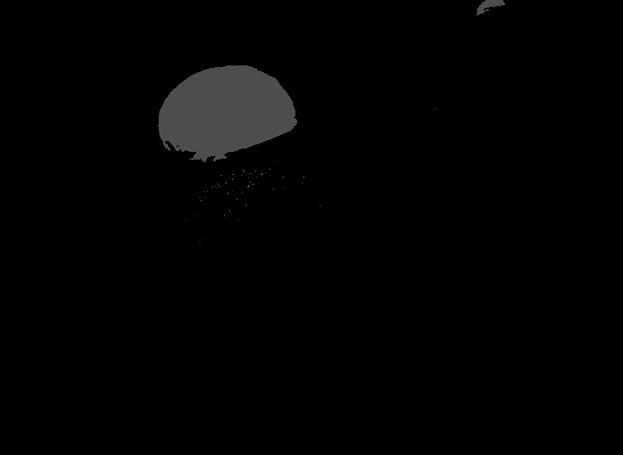
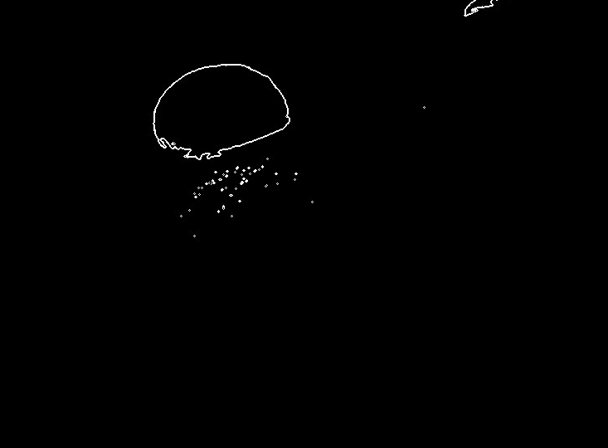
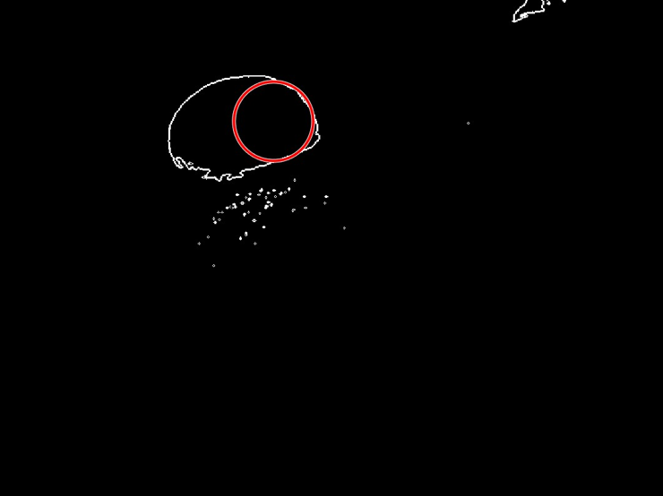
Everything Together (Sim results)
CAMERA
X = 133
Y = 308
GREY SCALE + COLOR MASK
EDGE DETECTION
OBJECT DETECTION

Slide 31
Ch3: Visual Output
Visaal

Slide 32
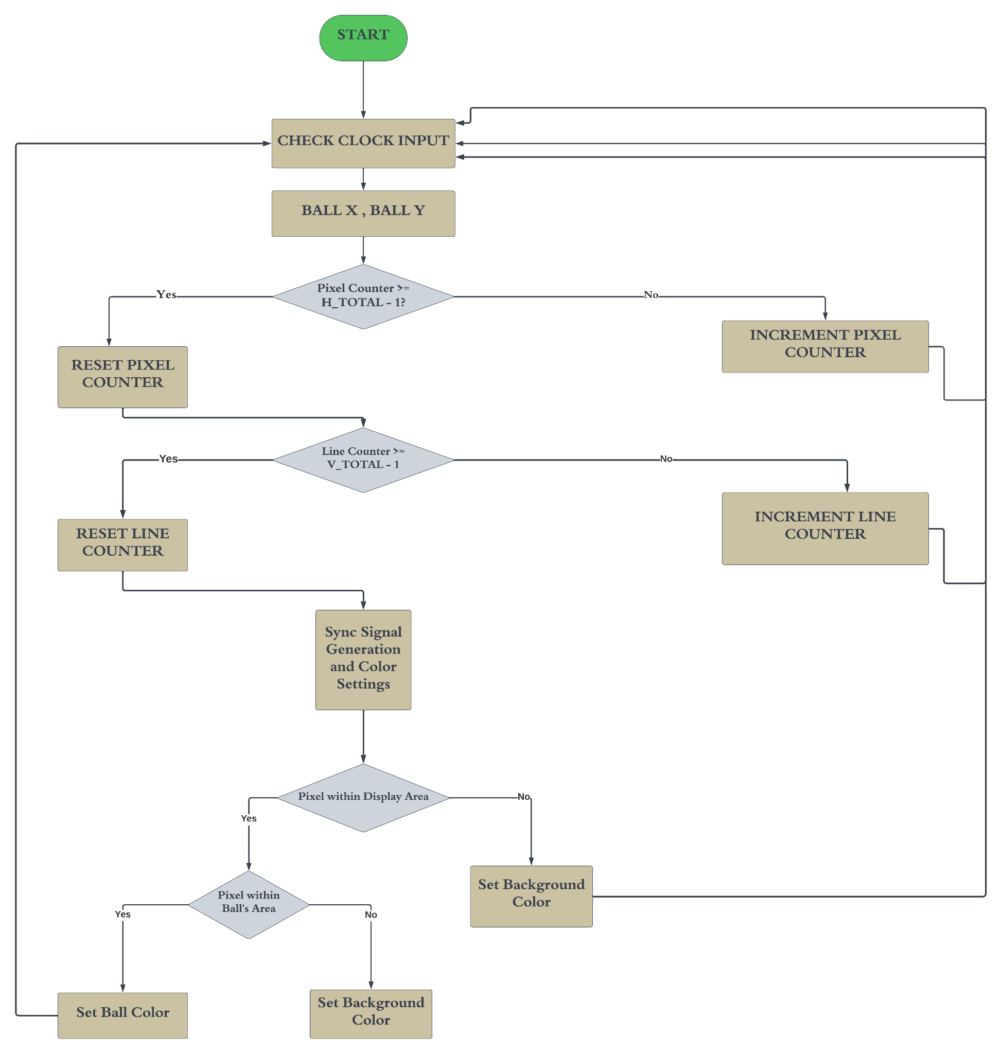
Flowchart

Slide 33
Visual Output
Key Functionalities:
Sync Signal Generation: Ensures frame synchronization for precise image display.
Pixel and Line Counter Checks: Maintains image clarity by accurately tracking pixel positions and line sequences.
Display Area Checks:
Utilizes algorithms to confirm that the display area accurately reflects the processed image, ensuring fidelity between the detected object and its visual representation.
Simulation Results:
Successful generation and timing of VGA signals, ensuring precise visual output.
Consistent pixel and line tracking.

Slide 34
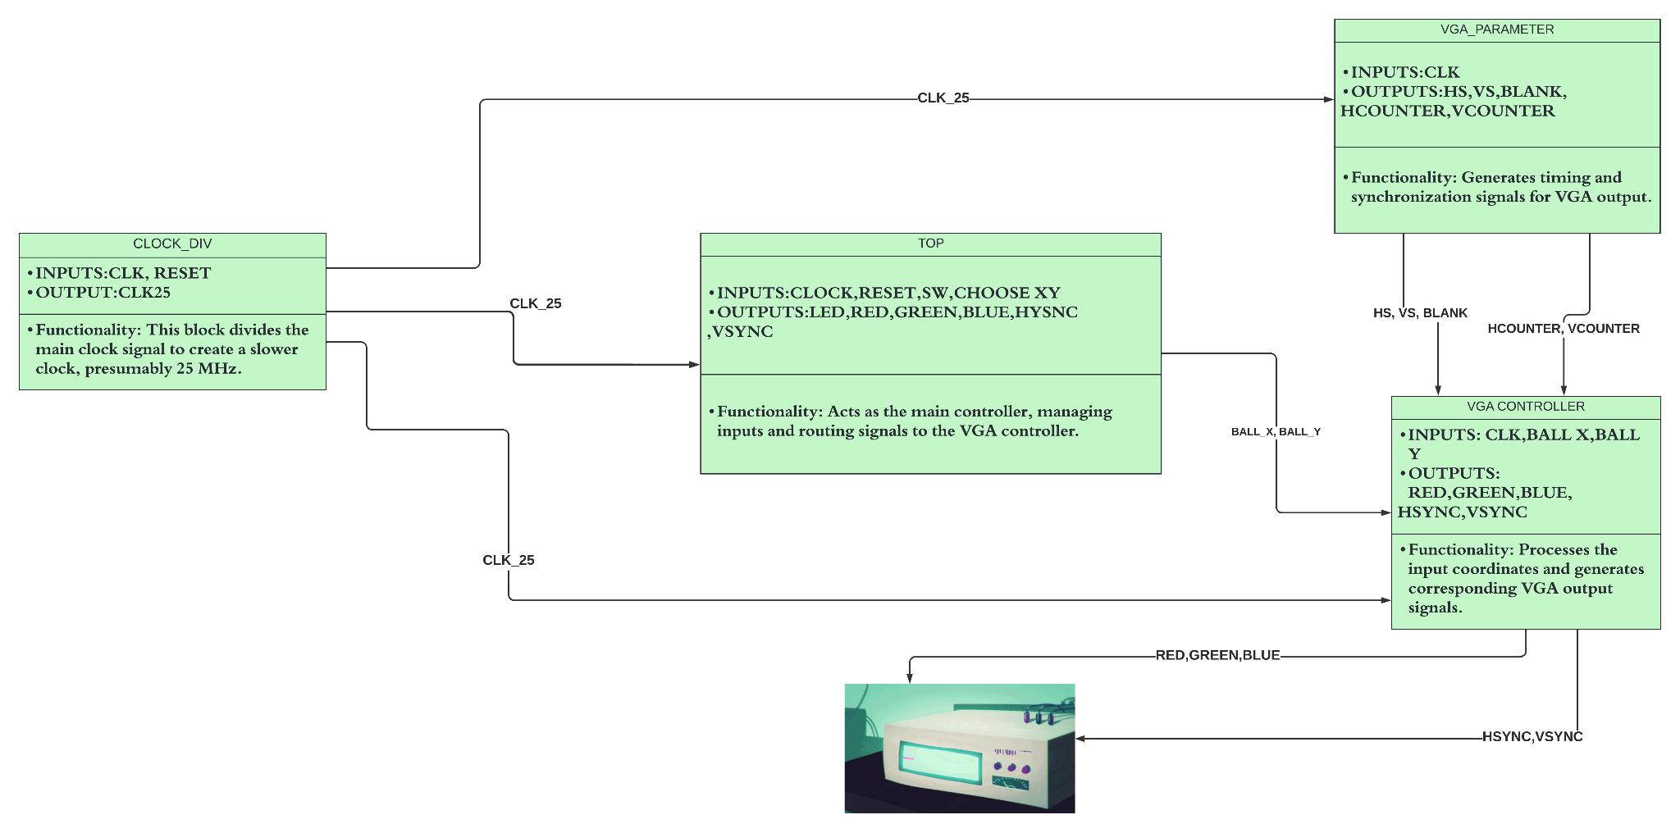
BLOCK DIAGRAM: WORKING AND CONNECTIONS

Slide 35
VISUAL OUTPUT
always @(*) begin if (vga_blank | ~inBounds) begin red = 0; green = 0; blue = 0; end else begin if (ballDetections) begin red <= 4'h0; green <= 4'h0; blue <= 4'hF; end else begin red <= 15; green <= 15; blue <= 15; end end end
Blanking and Bounds Check: The condition if (vga_blank | ~inBounds) checks whether the current pixel is in a blanking interval (vga_blank) or outside the displayable area of the VGA screen (~inBounds).
Ball Detection: The variable ballDetections is used to determine if the current pixel lies within the coordinates of the ball (ball_x, ball_y).
Background Color: If the current pixel is not part of the ball (else part of if (ballDetections)), the RGB values are set to maximum (15), which typically represents white color.

Slide 36
VISUAL OUTPUT
always@(posedge pixel_clk)begin if (hcounter == HMAX) hcounter <= 0; else hcounter <= hcounter + 1; end always@(posedge pixel_clk)begin if(hcounter == HMAX) begin if(vcounter == VMAX) vcounter <= 0; else vcounter <= vcounter + 1; end end always@(posedge pixel_clk)begin if(hcounter >= HFP && hcounter < HSP) HS <= SPP; else HS <= ~SPP; end always@(posedge pixel_clk)begin if(vcounter >= VFP && vcounter < VSP) VS <= SPP; else VS <= ~SPP; end
Horizontal Counter (hcounter): Incremented with each positive edge of pixel_clk.Resets to 0 when it reaches the maximum horizontal count (HMAX), which signifies the end of a scan line.
Horizontal Sync Signal (HS): Generated based on the value of hcounter.HS is set to SPP (Sync Pulse Polarity- 1) when hcounter is within the horizontal sync pulse region (between HFP - front porch end, and HSP - sync pulse end).Otherwise, HS is set to the inverse of SPP(ZERO).
Vertical Counter (vcounter): Incremented when hcounter resets (i.e., at the end of each horizontal scan line).Resets to 0 when it reaches the maximum vertical count (VMAX), indicating the completion of a frame (all scan lines).
Vertical Sync Signal (VS): Generated based on the value of vcounter.It's set to SPP when vcounter is in the vertical sync pulse region (between VFP and VSP).Otherwise this region, VS is set to the inverse of SPP.

Slide 37
Functionality Detailed
Check Clock Input: Checks for the positive edge of the clock signal.
Process Inputs (ball_x, ball_y): Processes the inputs ball_x and ball_y, which represent the coordinates of the ball on the screen. These coordinates are used to determine where to draw the ball in the VGA display.
Pixel Counter Check ("Pixel Counter >= H_TOTAL - 1?"): Checks if the horizontal pixel counter has reached its limit (H_TOTAL - 1). This is essential for determining when to move to the next line on the VGA display.
Reset Pixel Counter: Resets the horizontal pixel counter to 0. This occurs at the end of each line of pixels, preparing the controller to start the next line.
Increment Pixel Counter: Increments the horizontal pixel counter by 1. This is done for each clock cycle until the end of the line is reached.
Line Counter Check ("Line Counter >= V_TOTAL - 1?"): Checks if the vertical line counter has reached its limit (V_TOTAL - 1). This helps determine when the VGA display has completed one frame and needs to start a new frame.
Reset Line Counter: Resets the vertical line counter to 0. This is performed at the end of each frame, resetting the display to start drawing from the top again.
Increment Line Counter: Increments the vertical line counter by 1, moving down to the next line in the VGA frame. This occurs at the end of each horizontal line.
Generate Sync Signals: Generates the horizontal sync (hsync) and vertical sync (vsync) signals. These signals are used to synchronize the display with the VGA controller, indicating when a line or a frame ends.
Display Area Check ("Pixel within Display Area?"): Determines whether the current pixel position is within the active display area (the area where the image is actually drawn).
Ball Position Check ("Pixel within Ball's Area?"): Checks if the current pixel falls within the coordinates of the ball. This determines whether to color the pixel as part of the ball or as part of the background.
Set Ball Color: If the current pixel is within the ball's area, this block sets the RGB values to display the ball's color.
Set Background Color: If the current pixel is not within the ball's area, this block sets the RGB values to display the background color.

Slide 38
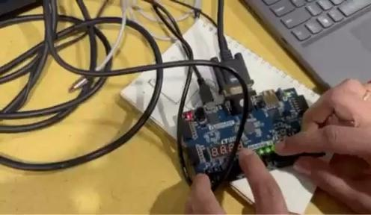
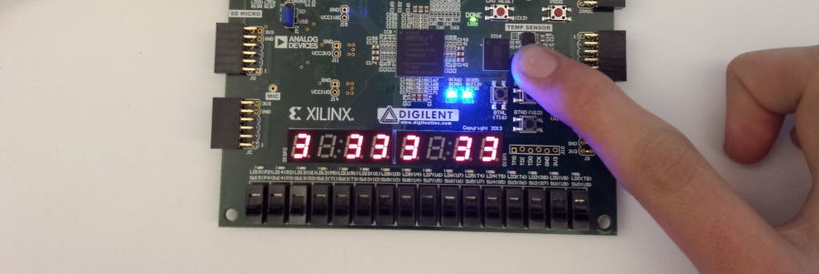
Simulation result

Slide 39
Tradeoffs
Memory Capacity: Using Basys 3 over Nexys 7 results in reduced memory capacity
Camera Integration: ESP32-CAM is a combined microcontroller and camera, unlike standalone cameras
Camera Resolution: ESP32-CAM offers higher and adjustable resolution unlike cameras connected directly to the FPGA board
FPS: frame rate affected by conversions from the PC and camera
Image Format: using BMP instead of JPEG simplifies processing requirements but requires conversion

Slide 40
Successes
- ESP32-CAM creates viewable images that can interact with other devices
- Image can be transferred to other devices
- The camera works
Successfully implemented the necessary steps to detect an object:
- Image masking
- Grey scaling
- Edge detection
- Object detection
- VGA script that can display the position of ball using a marker given only the X and Y coordinates.
- Simulated and synthesized onto a FPGA to test and verify the functionality of the module.

Slide 41
Failures
- Original camera OV7670 could not be configured to work or was DOA
- ESP32-CAM has trouble supporting JPEG to RGB888 conversions on-board
- Camera produces RGB static
- Creates system bottleneck
- Could improve performance by increasing # of threads:
- Ex: have non-dependent blocks of image run in parallel.
- More efficient use of memory:
- Ex: might be smarter to store only the necessary sections of the image.
- Despite having a working logic for a trace line feature that would visualize the ball's trajectory, we faced limitations due to the available memory on the FPGA.

Slide 42
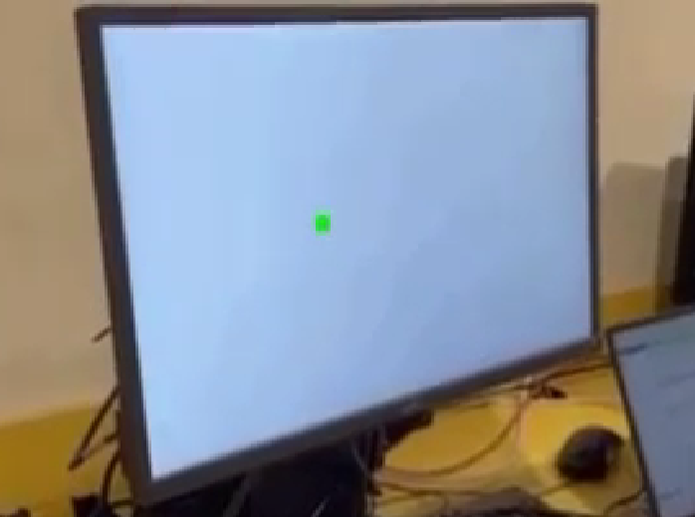
Where were we?

Slide 43
What we accomplished

Slide 44
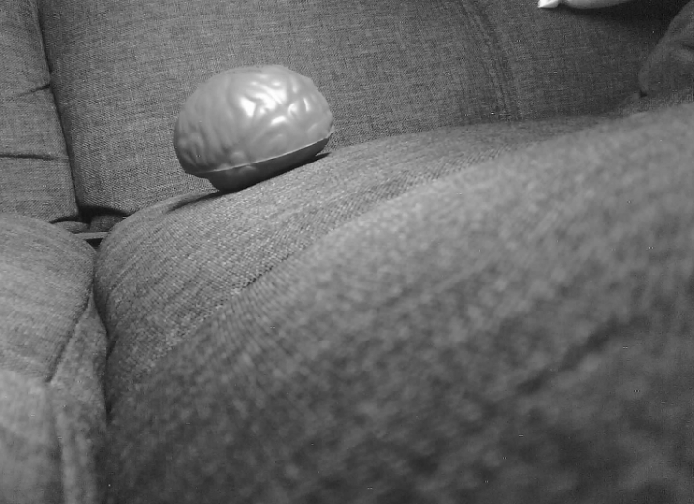
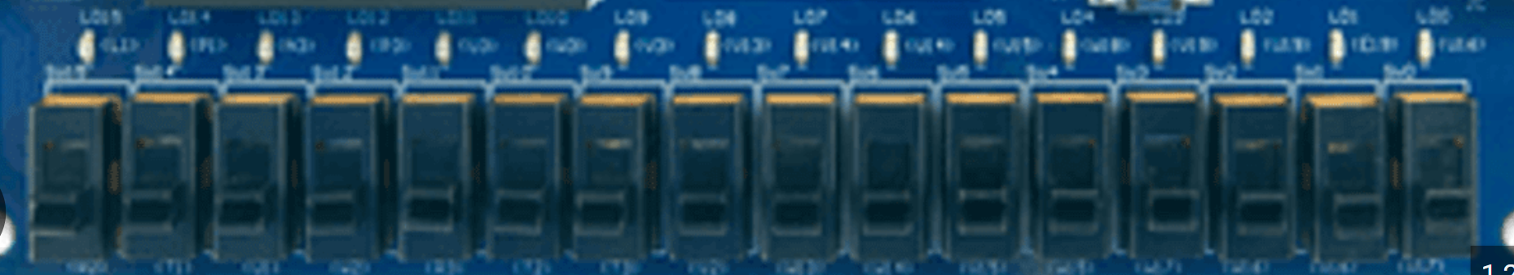
Integration on Basys 3
CAMERA
BRAM Grey Scale
Store grey scaled pixels
BRAM Edge
Store edge detection + color masking pixels
Hough Transform
Determine position of object
Visual Output 1
Visual Output 2
Visual Output 3
Disclaimer:
Images seen on this slide are from individual module testing and not the integrated model, i.e. the final model.
Notes:
In order to test and verify the functionality of the VGA module, we synthesized the module with switches acting as the input by setting the X and Y coordinates of the ball. Here the user can set a value for the X coordinate by using the first 9 switches and toggling one specific switch will allow to change the coordinate being controlled from X to Y. This way the VGA module can be simulated and tested to prove that positions generated from the image processing module will successfully be displayed on the monitor.

Slide 45

Thank you! Now, LIVE DEMO!
https://github.com/agwoska/DetectoVision

Slide 46
Ch4: Backup Slides

Slide 47
Original Testbench Images

Slide 48
Grey Scale and Color Mask

Slide 49
Edge detection

Slide 50
Our Example

